Slide 1
2.2 Internet Basics

Slide 2
Objectives
Describe the difference between Internet and World Wide Web.
Describe web browsers and their uses.
Identify screen components of Internet Explorer.

Slide 3
Objectives
Identify the basic parts of the World Wide Web.
Identify the components of a URL.
Conduct effective Internet searches.

Slide 4
Objectives
Understand search results.
Evaluate web sites.
Discuss Cyber Safety (safety on the Internet).

Slide 5
What is a Network?
A network is two or more computers connected by cables, telephone lines,
radio waves, satellites, or
infrared light beams.

Slide 6
What is the Internet?
The Internet is a global network of networks with billions of connected computers.

Slide 7
What is the World Wide Web?
People often use the words "the Internet" and "the web“ interchangeably. Is there a difference?

Slide 8
What is the World Wide Web?
The World Wide Web is the system we use to access the Internet.
Email and instant messaging are other systems we use to access the Internet.

Slide 9
How to Use the Web?
We use programs called web browsers to use the World Wide Web for a wide variety of purposes.

Slide 10
We Use the Web to…
communicate
play
&
Shop
learn
earn

Slide 11
Web Browsers
The most widely used browsers are:
Internet Explorer (Windows Default)
Chrome
Safari (MacIntosh/Iphone Default)
Mozilla Firefox

Slide 12
Internet Explorer
We are going to use Internet Explorer for our lesson today because it is the default browser on all Windows computers.

Slide 13
Browser Terminology
Because of different layouts and appearances of different browsers we are going to focus on browser terminology.
If you know the name of a feature you will be able to find it in another program.

Slide 14
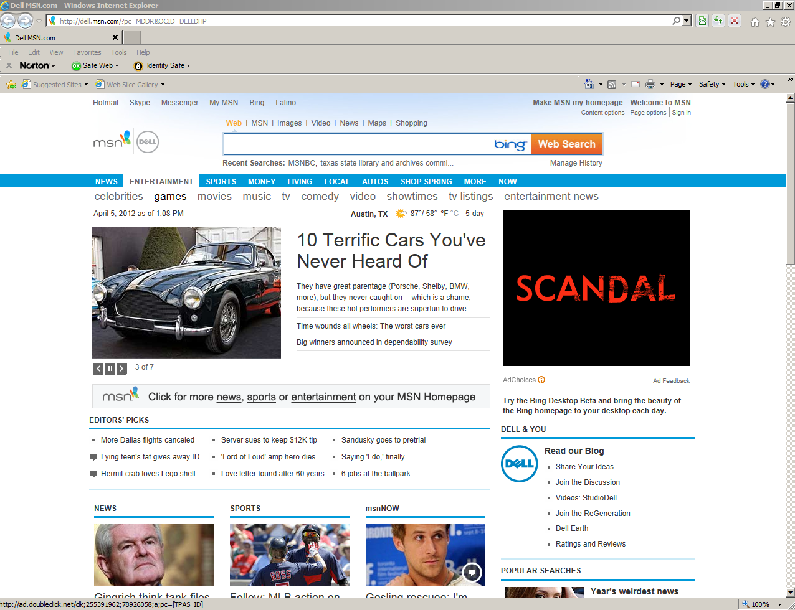
Internet Explorer From the Top Down
Title Bar: this is where the name of the program is usually displayed. It also contains the Minimize, Maximize/Restore and Close buttons (next slide)

Slide 15
Internet Explorer From the Top Down
Minimize: Reduces the Window to a tab on the startup bar.
Restore / Maximize: Restores the Window to its previous size or enlarges it to fill the screen.
Close: Closes the program.

Slide 16
Internet Explorer From the Top Down
Address Bar: this is where the name of the URL or web address is displayed and/or typed in by the user.

Slide 17
Internet Explorer From the Top Down
Back Button: takes you to previously viewed web pages.
Forward Button: takes you to the web page you were on before you clicked the back button.

Slide 18
Internet Explorer From the Top Down
Compatibility View: Improves the appearance of web pages created for previous versions of Internet Explorer.
Refresh: Reloads the current web page and shows any updates that might have occurred while you were viewing the page.

Slide 19
Internet Explorer From the Top Down
Stop: Stops the current page from loading.
Home, Favorites, Tools: Easy access to commands that can also be found on the menu bar.

Slide 20
Internet Explorer From the Top Down
Tabs:
Shows the current web page when brought to the front by clicking on it.
You can have several tabs open at once and move easily from one page to another by clicking on its tab.
In newer versions of Internet Explorer, tabs opened from similar web sites are color coded!

Slide 21
Internet Explorer From the Top Down
Other Toolbars: Look to see if you have other toolbars on your browser. This image shows a Norton antivirus software toolbar.

Slide 22
Internet Explorer From the Top Down
Favorites Bar: Provides an easy way to add a web site to your favorites bar and updates you when your favorite links are updated.

Slide 23
Internet Explorer From the Top Down
Command Bar: Provides an easy way to add a web site to your favorites bar and updates you when your favorite links are updated.

Slide 24
Internet Explorer From the Top Down
Status Bar: The left side provides the status of the browser. For example, it might tell you the page is loading or that it is waiting for a response from the webpage you are trying to access.
The right side tells you what percentage you are viewing the page at. 100% is typical. You can view it at a larger percentage but you might have to scroll over and down to see the entire page.

Slide 25
Things to know before surfing or searching the World Wide Web!

Slide 26
Hyperlink
Hyperlink
A hyperlink is a command embedded in text or an object which, when clicked, will open another file, take you to another place in the same file or to a new location on the internet.
Example: this text is hyperlinked

Slide 27
Hyperlink
A hyperlink is a command embedded in text or an object which, when clicked, will open another file, take you to another place in the same file or to a new location on the internet.
Example: this graphic is hyperlinked

Slide 28
Hyperlink
Hyperlinks provide an easy way to navigate throughout the world wide web but it is important to know what the hyperlink is linked to before you click on it!

Slide 29
Hyperlink
When you put your cursor over a hyperlink on a web page, the URL (Uniform Resource Locator or Web Address) shows up on the left hand side of the status bar.

Slide 30
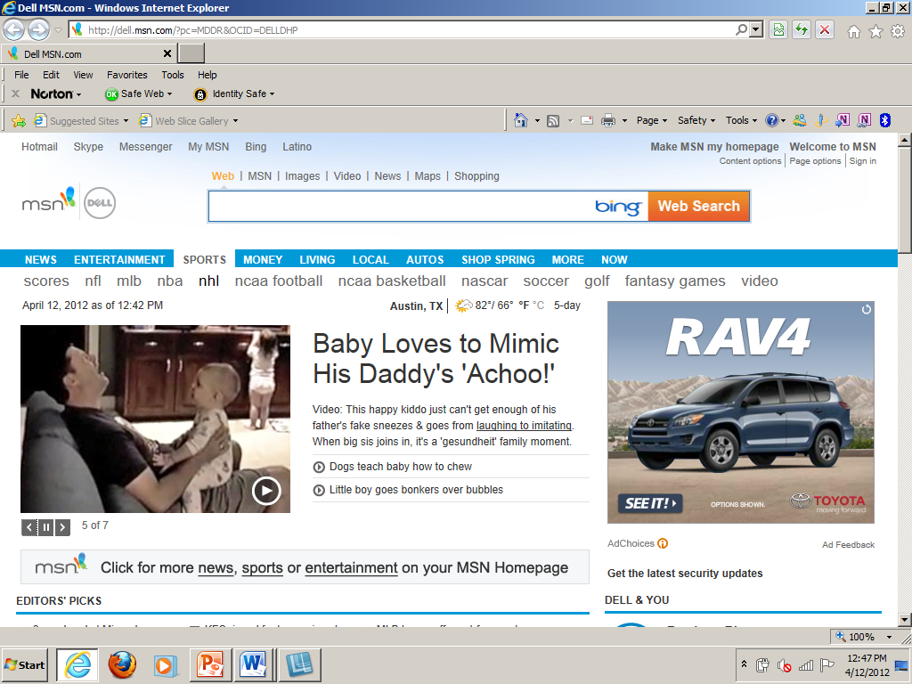
Example

Slide 31
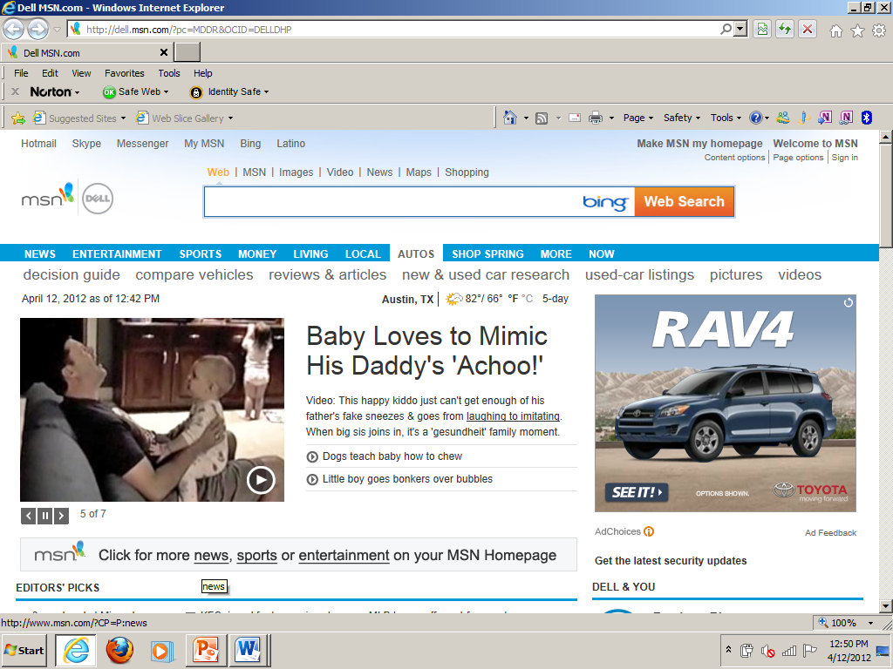
Website Example

Slide 32
The Bits & Pieces of a URL / Web Address
In order to recognize a suspicious web address, you need to know what a legitimate web address looks like!

Slide 33
The Bits & Pieces of a URL / Web Address
https://www.tsl.state.tx.us/
hypertext transfer protocol = Protocol used for all files on the web.
The added s indicates a higher level of security for information on those pages.

Slide 34
The Bits & Pieces of a URL / Web Address
https://www.tsl.state.tx.us/
The host name.
world wide web.texas state library

Slide 35
The Bits & Pieces of a URL / Web Address
https://www.tsl.state.tx.us/
The domain name address.
The sub-domain is state, indicating a state government site
The top-level domain is tx.us, indicating the geographic location of Texas,
United States

Slide 36
The Bits & Pieces of a URL / Web Address
https://www.tsl.state.tx.us/
landing/other-programs.html
The directory (also known as a folder)
File name
File extension

Slide 37
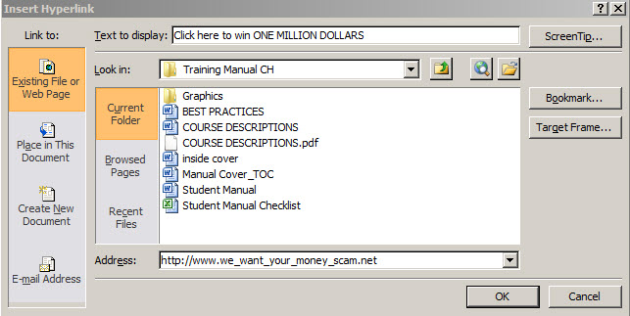
Caution
Be careful what you click on!

Slide 38
The Bits & Pieces of a URL / Web Address
Legitimate ☺ Facebook URL
http://www.facebook.com/about/privacy/
Illegitimate ☹ (Hoax) Facebook URL
http://unblock.facebookproxy.com
Host name
is different
Domain Name Address
is different

Slide 39
Common Top Level Domains by Type
Domain | Description
.edu | A college or university
.com | Commercial business site
.gov | U.S. Government / non- military site
.net | Networks, Internet service providers, organizations & personal sites
.mil | U.S. Military & Agencies sites
.org | Non-profit organizations and others

Slide 40
Common Top Level Domains by Country
Domain | Country
.es | Spain
.fr | France
.ca | Canada
.mx | Mexico
.dd | Germany
.nz | New Zealand

Slide 41
How to Use the World Wide Web

Slide 42
Choose a Homepage
Your home page is the first page to be displayed when you open the web browser, in this case the web browser is Internet Explorer.

Slide 43
Default Homepage
Internet Explorer comes pre-installed on your computer and has a default home page.
If you find a page you would rather have as your homepage you can change the settings. (see handout)

Slide 44
Address Bar
If you know the URL or Address for the website you would like to view, you can type it in on the address bar.

Slide 45
If you do not know the address of a web site, you can search for it using any search engine.
Search Engines

Slide 46
Search engines are programs that search documents for specified keywords and returns a list of the documents where the keywords were found.
Search Engines

Slide 47
Just about every website has a search feature which will either search the web or search within its own web site. We are going to concentrate on three of the most popular search engines.
Search Engines

Slide 48
Search Engines
The THREE most widely used Search Engines are:

Slide 49
Time To Search The World Wide Web!

